Slide 1
Descriptive and inferential statistical methodologies has proven effective in creating a proactive ‘alarm’, accurately identifying Pump Failures with Horse Power (HP) and Pump Efficiency (PE) emerging as key variables of interest with deviations of 3 HP and > 15 % Pump Efficiency being our core signal thresholds.

Slide 2
Descriptive Analysis has enabled us to clearly identify particular signature abnormalities showing clear signature changes in both Rolling Standard Deviation and Rolling Mean Datasets when observed over the respective failure period of interest.

Slide 3
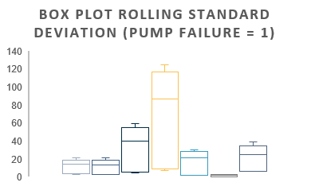
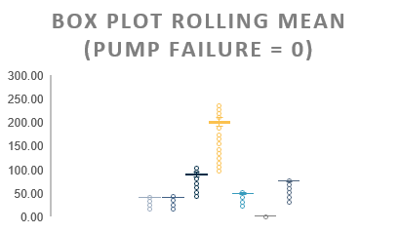
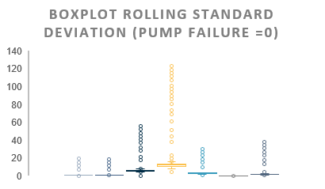
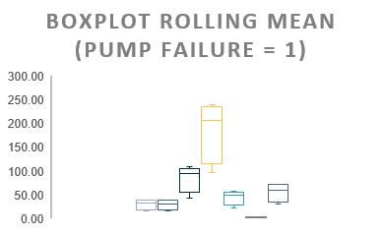
Further segmentation of the data via binary means (Pump Failure = 0 or 1) illustrated through boxplots, show a clear signature difference between that of normal behaviour and that of Failure with Pump Torque, Pump Efficiency, Ambient Temperature showing the largest overall variances.

Slide 4
Correlation analyses across datasets yield particularly interesting insights with Volumetric Flow (-0.69) and Pump Efficiency (-0.70) negatively correlated with Pump Failure in the Rolling Mean Data, whilst Horse Power (0.70), Volumetric Flow Meter 1 (0.66) and Pump Efficiency show a strong positive correlation in the Rolling Stdev Dataset.

Slide 5
Lastly, analysis of the model fit reveals that with a R Squared of 0.77, a linear model is a good fit for the data with Horse Power, Pump Efficiency and Volumetric Flow Meter 2 having the largest coefficients, indicative that these variables have the most absolute rate of change with respect to Pump Failure behaviour.

